Slide 1
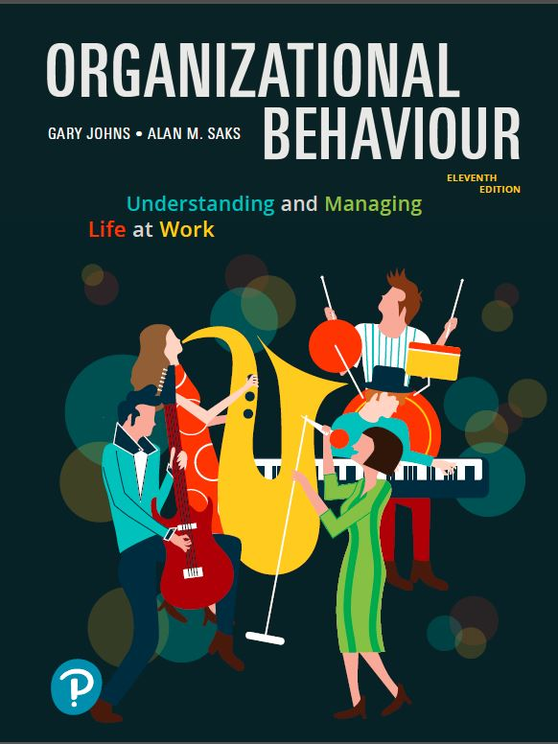
Organizational Behaviour:
Understanding and Managing Life at Work
Eleventh Edition
Chapter 3
Perception, Attribution, and Diversity
Copyright © 2020 Pearson Canada Inc.

Slide 2
Learning Objectives (1 of 2)
LO3.1 Define perception and discuss some of the general factors that influence perception.
LO3.2 Explain social identity theory and Bruner’s model of the perceptual process.
LO3.3 Describe the main biases in person perception.
LO3.4 Describe how people form attributions about the causes of behaviour and various biases in attribution.

Slide 3
Learning Objectives (2 of 2)
LO3.5 Discuss the concepts of workforce diversity and valuing diversity and how racial, ethnic, religious, gender, age, and LGBTQ stereotypes affect organizational behaviour and what organizations can do to manage diversity.
LO3.6 Define trust perceptions and perceived organizational support, and describe organizational support theory.
LO3.7 Discuss person perception and perceptual biases in human resources management.

Slide 4
What Is Perception?
The process of interpreting the messages of our senses to provide order and meaning to the environment.
People base their actions on the interpretation of reality that their perceptual system provides, rather than on reality itself.

Slide 5
Components of Perception
Perception has three components:
  A perceiver
  A target that is being perceived
  Some situational context in which the perception is occurring
Each component influences the perceiver’s impression or interpretation of the target.

Slide 6
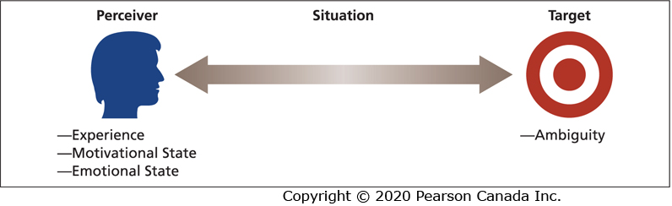
Factors That Influence Perception

Slide 7
The Perceiver
Past experiences lead the perceiver to develop expectations that affect current perceptions.
Needs unconsciously influence perceptions by causing us to perceive what we wish to perceive.
Emotions, such as anger, happiness, or fear, can influence our perceptions.

Slide 8
Perceptual Defence
The tendency for the perceptual system to defend the perceiver against unpleasant emotions.
People often “see what they want to see” and “hear what they want to hear.”
Our perceptual system works to ensure we do not see or hear things that are threatening.

Slide 9
The Target
Ambiguous targets are especially susceptible to interpretation and the addition of meaning.
Perceivers have a need to resolve ambiguities.
The perceiver does not or cannot use all the information provided by the target.
A reduction in ambiguity might not be accompanied by greater accuracy.

Slide 10
The Situation
Perception occurs in some situational context, and this context can affect what is perceived.
The most important effect that the situation can have is to add information about the target.
The perception of a target can change with the situation even when the perceiver and target remain the same.

Slide 11
Social Identity Theory (1 of 3)
People form perceptions of themselves based on their personal characteristics and memberships in social categories.
Our sense of self is composed of a personal identity and a social identity.

Slide 12
Social Identity Theory (2 of 3)
Personal identity is based on our unique personal characteristics (e.g., interests).
Social identity is based on our perception that we belong to various social groups (e.g., gender).
Personal and social identities help us answer the question: “Who am I?”

Slide 13
Social Identity Theory (3 of 3)
We perceive ourselves and others as embodying the most typical attributes of a category or what are called “prototypes.”
We also form perceptions of others based on their membership in social categories.
Social identities are relational and comparative.
People tend to perceive members of their own social categories in more positive and favourable ways.

Slide 14
Bruner’s Model of the Perceptual Process (1 of 2)
When the perceiver encounters an unfamiliar target, the perceiver is very open to the informational cues in the target and the situation.
The perceiver will actively seek out cues to resolve ambiguity.
As the perceiver encounters some familiar cues, a crude categorization of the target is made.

Slide 15
Bruner’s Model of the Perceptual Process (2 of 2)
The search for cues then becomes less open and more selective.
The perceiver will search for cues that confirm the categorization of the target.
As the categorization becomes stronger, the perceiver will ignore or even distort cues that violate initial perceptions.

Slide 16
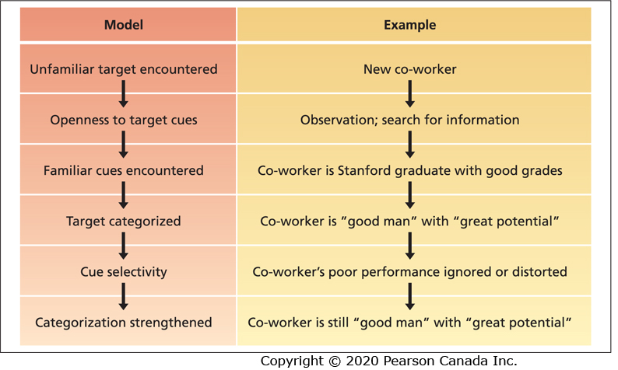
Bruner’s Model of the Perceptual Process: An Example

Slide 17
Characteristics of the Perceptual Process
Bruner’s model demonstrates three important characteristics of the perceptual process:
  Perception is selective
  Perceptual constancy
  Perceptual consistency

Slide 18
Perception Is Selective
Perceivers do not use all of the available cues, and those they do use are given special emphasis.
Perception is efficient but this can aid and hinder perceptual accuracy.

Slide 19
Perceptual Constancy
The tendency for the target to be perceived in the same way over time and across situations.
The experience of “getting off on the wrong foot.”

Slide 20
Perceptual Consistency
The tendency to select, ignore, and distort cues so that they fit together to form a homogenous picture of the target.
We strive for consistency in our perception of people.

Slide 21
Basic Biases in Person Perception
The impressions we form of others are susceptible to a number of perceptual biases:
  Primacy and recency effects
  Reliance on central traits
  Implicit personality theories
  Projection
  Stereotyping

Slide 22
Primacy Effect
The reliance on early cues or first impressions is known as the primacy effect.
Primacy can have a lasting impact.
Primacy is a form of selectivity and its lasting effects illustrate the operation of constancy.

Slide 23
Recency Effect
The tendency for a perceiver to rely on recent cues or last impressions is known as the recency effect.
Last impressions count most.

Slide 24
Reliance on Central Traits (1 of 3)
People tend to organize their perceptions around central traits.
Central traits are personal characteristics of a target person that are of particular interest to a perceiver.
Central traits often have a very powerful influence on our perceptions of others.

Slide 25
Reliance on Central Traits (2 of 3)
Physical appearance is a common central trait in work settings.
Conventionally attractive people fare better than unattractive people in terms of a variety of job-related outcomes (e.g., getting hired).

Slide 26
Reliance on Central Traits (3 of 3)
Physical height is an obvious aspect of physical appearance that is related to job performance, promotions, and career success.
Individuals who are overweight tend to be evaluated negatively on a number of workplace outcomes.

Slide 27
Implicit Personality Theories
Personal theories that people have about which personality characteristics go together.
Perhaps you expect hardworking people to also be honest, or people of average intelligence to be friendly.
If such implicit theories are inaccurate, they provide a basis for misunderstanding.

Slide 28
Projection
The tendency for perceivers to attribute their own thoughts and feelings to others.
In some cases, projection is an efficient and sensible perceptual strategy.
Projection can lead to perceptual difficulties and can serve as a form of perceptual defence.

Slide 29
Stereotyping (1 of 3)
The tendency to generalize about people in a social category and ignore variations among them.
Categories on which people might base a stereotype include race, religion, age, gender, ethnic background, social class, and occupation.

Slide 30
Stereotyping (2 of 3)
There are three specific aspects to stereotyping:
  We distinguish some category of people.
  We assume that the individuals in this category have certain traits.
  We perceive that everyone in this category possesses these traits.

Slide 31
Stereotyping (3 of 3)
People can evoke stereotypes with very little information.
Stereotypes help us develop impressions of ambiguous targets.
Most stereotypes are inaccurate, especially when we use them to develop perceptions of specific individuals.

Slide 32
Why Do Stereotypes Persist?
Several factors work to reinforce inaccurate stereotypes.
Even incorrect stereotypes help us process information about others quickly and efficiently.
Inaccurate stereotypes are often reinforced by selective perception.

Slide 33
Attribution: Perceiving Causes and Motives
Attribution is the process by which we assign causes or motives to explain people’s behaviour.
Rewards and punishments in organizations are based on judgments about what really caused a target person to behave in a certain way.
An important goal is to determine whether some behaviour is caused by dispositional or situational factors.

Slide 34
Dispositional Attributions
Dispositional attributions suggest that some personality or intellectual characteristic unique to the person is responsible for the behaviour.
Intelligence, greed, friendliness, or laziness.

Slide 35
Situational Attributions
Situational attributions suggest that the external situation or environment in which the target person exists was responsible for the behaviour.
Bad weather, good luck, proper tools, or poor advice.

Slide 36
Attribution Cues
We rely on external cues and make inferences from these cues when making attributions.
Three implicit questions guide our decisions as to whether we should attribute some behaviour to dispositional or situational causes.

Slide 37
Three Attribution Questions
Does the person engage in the behaviour regularly and consistently? (Consistency cues).
Do most people engage in the behaviour, or is it unique to this person? (Consensus cues).
Does the person engage in the behaviour in many situations, or is it distinctive to one situation? (Distinctiveness cues).

Slide 38
Consistency Cues
Attribution cues that reflect how consistently a person engages in a behaviour over time.
High consistency behaviour leads to dispositional attributions.
When behaviour occurs inconsistently, we begin to consider situational attributions.

Slide 39
Consensus Cues
Attribution cues that reflect how a person’s behaviour compares with that of others.
Low consensus behaviour leads to dispositional attributions.
The informational effects of low-consensus behaviour are magnified when the actor is expected to suffer negative consequences because of the deviance.

Slide 40
Distinctiveness Cues
Attribution cues that reflect the extent to which a person engages in some behaviour across a variety of situations.
Low distinctiveness behaviour leads to a dispositional attribution.
When a behaviour is highly distinctive, in that it occurs in only one situation, we are likely to assume that some aspect of the situation caused the behaviour.

Slide 41
Attribution in Action (1 of 2)
Observers put information about consistency, consensus, and distinctiveness together to form attributions.
Consider three employees who are absent from work.
A manager must develop an attribution about the cause to decide which action is warranted.

Slide 42
Attribution in Action (2 of 2)
Roshani is absent a lot, her co-workers are seldom absent, and she was absent a lot in her previous job.
Mika is absent a lot, her co-workers are also absent a lot, but she was almost never absent in her previous job.
Sam is seldom absent, her co-workers are seldom absent, and she was seldom absent in her previous job.

Slide 43
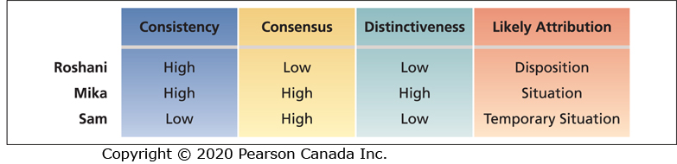
Cue Combinations and Resulting Attributions

Slide 44
Biases in Attribution
Although observers often operate in a rational, logical manner in forming attributions about behaviour, this does not mean that such attributions are always correct.
Three biases in attribution:
  Fundamental attribution error
  Actor-observer effect
  Self-serving bias

Slide 45
Fundamental Attribution Error
The tendency to overemphasize dispositional explanations for behaviour at the expense of situational explanations.
We often discount the strong effects that social cues can have on behaviour.
We often observe people in constrained and constant situations and fail to realize that observed behaviour is distinctive to a particular situation.

Slide 46
Actor-Observer Effect
The propensity for actors and observers to view the causes of the actor’s behaviour differently.
Actors are prone to attribute much of their own behaviour to situational factors while observers are more likely to invoke dispositional causes.
Why are actors prone to attribute much of their own behaviour to situational causes?

Slide 47
Self-Serving Bias
The tendency to take credit for successful outcomes and to deny responsibility for failures.
People will explain the very same behaviour differently on the basis of events that happened after the behaviour occurred.
Self-serving bias can reflect intentional self-promotion or excuse making or it might reflect unique information on the part of the actor.

Slide 48
Person Perception and Workforce Diversity
Workforce diversity refers to differences among recruits and employees in characteristics, such as gender, race, age, religion, cultural background, physical ability, or sexual orientation.
The workforce is becoming more diverse.
Many organizations have not successfully managed workforce diversity.

Slide 49
The Changing Workplace (1 of 2)
The Canadian population and labour force is becoming increasingly multicultural and multiethnic.
By 2031, 30.6 percent of the population will be visible minorities.
By 2021 one in four employees will be 55 or older, and by 2031 persons over 65 will make up about 23 percent of the population.

Slide 50
The Changing Workplace (2 of 2)
Many organizations are seeking to recruit more representatively from the labour pool.
Many employees are required to interact with people from substantially different national or corporate cultures.
The increased emphasis on teamwork as a means of job design and quality enhancement also requires people from different cultures to work together.

Slide 51
Valuing Diversity (1 of 4)
Some have argued that organizations should value diversity not just tolerate it.
A critical motive is the basic fairness of valuing diversity.

Slide 52
Valuing Diversity (2 of 4)
Diversity and its proper management can yield strategic and competitive advantages:
  Improved problem solving and creativity.
  Improved recruiting and marketing.
  Improved competitiveness in global markets.

Slide 53
Valuing Diversity (3 of 4)
Organizations are adopting diversity as part of their corporate strategy to improve their competitiveness in global markets.
A diversity climate is related to business-unit performance.
Retail stores have higher customer satisfaction and productivity when their employees represent the ethnicity of their customers.

Slide 54
Valuing Diversity (4 of 4)
A match between racial diversity in a store and racial diversity in the community is positively related to sales performance.
Organizations with more gender-diverse management teams have superior financial performance.

Slide 55
Competitive Advantages to Valuing and Managing a Diverse Workforce
Cost
Resource-Acquisition
Marketing
Creativity
Problem-Solving
System Flexibility

Slide 56
Stereotypes and Workforce Diversity
(1 of 2)
A major barrier to valuing diversity is the stereotype.
The tendency to generalize about people in a certain social category and ignore variations among them.
Common workplace stereotypes are based on gender, age, race, religion, ethnicity, and sexual orientation.
Stereotypes can have negative effects on how individuals are treated in organizations.

Slide 57
Stereotype Threat
Members of a social group feel they might be judged or treated according to a stereotype and that their behaviour and/or performance will confirm the stereotype.
The activation of a salient negative stereotype threat in a testing situation has been found to result in lower cognitive ability and math test performance scores of minorities and women.
Workers are often pressured to cover up or downplay their membership in a particular group.

Slide 58
Stereotypes and Workforce Diversity
(2 of 2)
Research indicates that both subtle and overt discrimination have a negative effect on employees’ physical and psychological health and work-related outcomes.

Slide 59
Racial, Ethnic, and Religious Stereotypes (1 of 3)
Racial, ethnic, and religious stereotypes are pervasive, persistent, frequently negative, and often contradictory.
Whites have been found to advance further in the hiring process than blacks.
One study found that female job applicants who appeared to be Muslim experienced more negative interpersonal behaviour and discrimination.

Slide 60
Racial, Ethnic, and Religious Stereotypes (2 of 3)
Visible minorities are underrepresented in leadership roles.
Discrimination in hiring has been found to occur when job applicants have an ethnic-sounding name.
Many minority applicants engage in “resumé whitening” by changing their name to sound anglicized or by removing experience with an ethnic group or organization.

Slide 61
Racial, Ethnic, and Religious Stereotypes (3 of 3)
Career advancement based on racial or ethnic stereotyping is common.
Visible minorities perceive more barriers in their career advancement, including a lack of fairness in the process, and report less career satisfaction than white colleagues.
Attributions can play an important role in determining how job performance is interpreted.

Slide 62
Gender Stereotypes (1 of 6)
One of the most problematic stereotypes for organizations is the gender stereotype.
Women are severely underrepresented in managerial and administrative jobs.
Women in Canada hold only 25 percent of vice-president positions and 15 percent of CEO positions.

Slide 63
Gender Stereotypes (2 of 6)
Stereotypes of women do not correspond well with stereotypes of business people or managers.
What is the nature of gender stereotypes?

Slide 64
Gender Stereotypes (3 of 6)
Successful managers are perceived as having traits and attitudes that are generally ascribed to men.
Successful managers are seen as more similar to men in qualities such as leadership ability, competitiveness, self-confidence, ambitiousness, and objectivity.
Stereotypes of successful middle managers do not correspond to stereotypes of women.

Slide 65
Gender Stereotypes (4 of 6)
The stereotype of a leader is culturally masculine.
Gender stereotypes lead to biased human resource decisions.
Women suffer from a stereotype that is detrimental to their hiring, development, promotion, and salaries.
Even women with MBAs earn less than men in their first year of work and start in more junior positions.

Slide 66
Gender Stereotypes (5 of 6)
The detrimental effects of gender stereotypes are reduced or removed with increased experience and training of decision makers and when decision makers:
  Are held accountable for their decisions
  Have good job-related information about the qualifications, competence, and performance of particular women
  Have an accurate picture of the job and its requirements

Slide 67
Gender Stereotypes (6 of 6)
Women do not suffer from gender stereotypes in performance evaluations that their supervisors provide.
A review of research on gender differences in job performance ratings found that females scored slightly higher than males, while males received higher ratings of promotion potential.

Slide 68
Age Stereotypes (1 of 7)
Knowing that a person falls into a certain age range or belongs to a particular age generation, we have a tendency to make certain assumptions about the person’s physical, psychological, and intellectual capabilities.
What is the nature of work-related age stereotypes?

Slide 69
Age Stereotypes (2 of 7)
Older workers are seen as having less capacity for performance.
They are viewed as less competent, adaptable, productive, creative, logical, and capable of performing under pressure, and as having lower performance and less potential for development.
They are perceived as more rigid and dogmatic, and less adaptable to new corporate cultures.
They are perceived as more honest, dependable, and trustworthy.

Slide 70
Age Stereotypes (3 of 7)
Younger workers are judged more negatively and experience age discrimination more frequently than older workers.
They tend to be viewed as less loyal, inexperienced, unmotivated, immature, and selfish compared to older workers.
They are perceived less favourably than older workers in terms of initiative, stability, and work experience.

Slide 71
Age Stereotypes (4 of 7)
These stereotypes are inaccurate.
Age seldom limits the capacity for development until post-employment years.
Research has found that age is not related to task performance or creativity.
However, age is related to other forms of job performance.

Slide 72
Age Stereotypes (5 of 7)
Older workers exhibit more citizenship and safety-related behaviours, and fewer counterproductive behaviours.
Older workers exhibit less workplace aggression, on-the-job substance use, tardiness, and absenteeism.
Do age stereotypes affect human resources decisions?

Slide 73
Age Stereotypes (6 of 7)
Age stereotypes affect human resource decisions regarding hiring, promotion, and skills development.
Older workers are often passed over for merit pay and promotions and pressured to take early retirement.
Research has found that younger workers (ages 18-30) experience the highest rates of age discrimination, followed by older workers (50 or older), and then middle-aged workers (ages 31-49).

Slide 74
Age Stereotypes (7 of 7)
Discriminatory behaviour experienced by both younger and older workers is associated with lower job attitudes and greater intentions to quit.
Some organizations have implemented programs and practices to promote the hiring of older and younger workers.

Slide 75
LGBTQ Stereotypes (1 of 3)
LGBTQ employees face barriers and discrimination in the workplace that can limit their career advancement.
Many LGBTQ employees do not come out at work for fear of the potential repercussions and negative consequences to their career and personal safety.
Why do LGBTQ employees face these barriers and fear coming out at work?

Slide 76
LGBTQ Stereotypes (2 of 3)
Lack of education and awareness and the reliance on stereotypes.
Misperceptions and stereotypes lead to discriminatory behaviour towards LGBTQ employees.
LGBTQ employees who do not feel safe to come out at work are less productive and more likely to suffer from depression and stress, and are more likely to quit.

Slide 77
LGBTQ Stereotypes (3 of 3)
An increasing number of organizations have begun to make their workplaces more inclusive for LGBTQ employees.
LGBTQ-inclusive workplaces can increase employee engagement and reduce turnover.
Organizations that implement programs to create an LGBTQ-inclusive workplace improve LGBTQ employee relationships with co-workers, and increase perceptions of fairness, organizational commitment, and career satisfaction which can lead to increased productivity.

Slide 78
Managing Workforce Diversity (1 of 3)
Diversity needs to be managed to have a positive impact on work behaviour and an organization.
What can organizations do to achieve and manage a diverse workforce?

Slide 79
Managing Workforce Diversity (2 of 3)
Select enough minority members to get them beyond token status.
Develop an employment equity plan.
Provide a flexible work environment.
Encourage teamwork that brings minority and majority members together.

Slide 80
Managing Workforce Diversity (3 of 3)
Ensure that those making career decisions about employees have accurate information about them.
Train people to be aware of stereotypes and to value diversity.

Slide 81
Diversity Training Programs
One of the most common approaches for managing diversity.
They can activate bias and cause disruption and bad feelings when all they do is get people to open up and voice their stereotypes.
Diversity training should be accompanied by skills training that is relevant to the particular needs of the organization.

Slide 82
Diversity Programs
Organizations should use a number of tactics in addition to training.
What is most important is that they integrate diversity into all of its policies and practices rather than treat diversity as a stand-alone practice.
Organizations that have been successful in managing diversity have an inclusive culture that values individual differences.

Slide 83
Perceptions of Trust (1 of 3)
Do you trust your boss and organization?
Employee trust in top organization leaders is at an all-time low.
Employee trust toward management is on the decline.
Trust perceptions influence organizational processes and outcomes.
What is trust?

Slide 84
What Is Trust?
A psychological state in which one has a willingness to be vulnerable and to take risks with respect to the actions of another party.
Trust perceptions toward management are based on three distinct perceptions:
  Ability
  Benevolence
  Integrity
The combination of these three factors influences perceptions of trust.

Slide 85
Perceptions of Trust (2 of 3)
Higher perceptions of management ability, benevolence, and integrity are related to greater perceptions of trust.
Perceptions of fairness are related to trust perceptions.
Trust in leaders at lower levels of an organization influences trust perceptions of leaders at higher-levels of the organization.

Slide 86
Perceptions of Trust (3 of 3)
Perceptions of trust in management and leaders are positively related to job attitudes and job performance, and negatively related to turnover intentions.
Trust among co-workers is also important and has been found to be related to fewer physical symptoms and less withdrawal from work.
Trust is considered to be the most critical factor when judging the best workplaces in Canada.

Slide 87
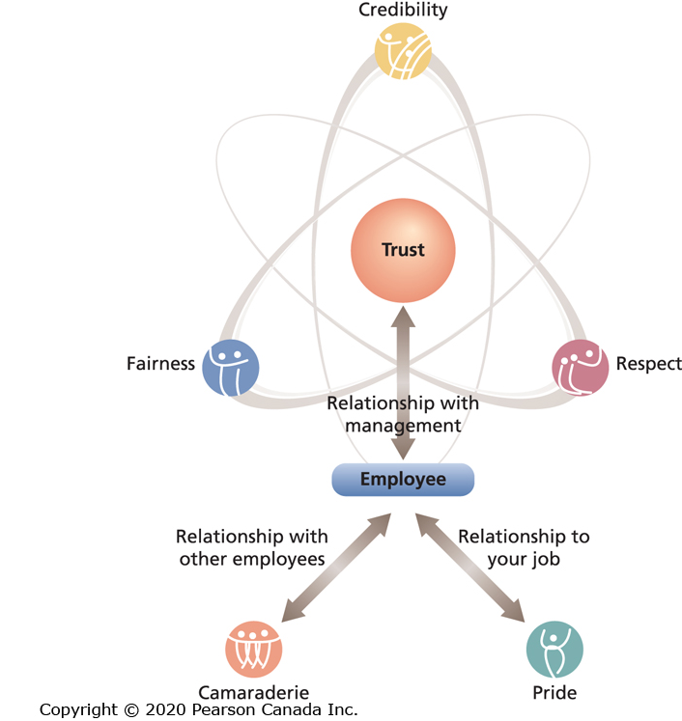
Trust Model

Slide 88
Perceived Organizational Support (POS) (1 of 5)
Employees’ general belief that their organization values their contribution and cares about their well-being.
When employees have positive POS, they believe their organization will provide assistance when they need it.

Slide 89
Organizational Support Theory
Employees who have strong POS feel an obligation to care about the organization’s welfare and to help the organization achieve its objectives.
Employees feel a greater sense of purpose and meaning and a strong sense of belonging to the organization.
Employees feel obligated to reciprocate the organization’s care and support - the norm of reciprocity.

Slide 90
Perceived Organizational Support (2 of 5)
Employees who have greater POS have higher trust toward the organization and management.
POS has a number of positive consequences for employees and organizations such as higher job satisfaction, organizational commitment, and job performance and lower absenteeism and turnover.
Employees with higher POS have a more positive mood at work and are more involved in their job and less likely to experience stress and strain symptoms.

Slide 91
Perceived Organizational Support (3 of 5)
Factors that contribute to POS include:
  Favourable treatment, support, and concern for one’s well-being from supervisors or what is known as perceived supervisor support (PSS).
  Fair organizational procedures.
  Favourable rewards and job conditions.
  Job enrichment.
  Human resource practices such as developmental opportunities and flexible work schedules.

Slide 92
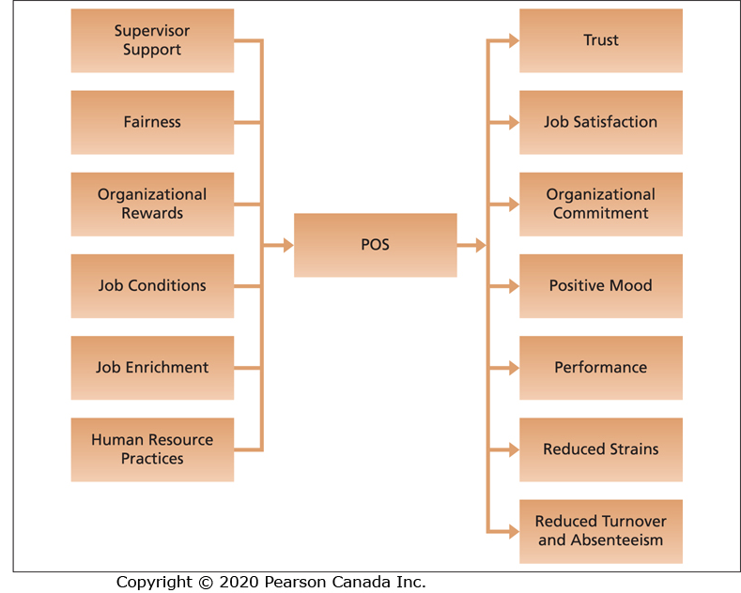
Predictors and Consequences of POS

Slide 93
Perceived Organizational Support (4 of 5)
What can organizations do to improve employee POS?
Supportive human resource practices that demonstrate an investment in employees and recognition of employee contributions are most likely to lead to the development of greater POS.

Slide 94
Perceived Organizational Support (5 of 5)
Supportive human resources practices include:
  Participation in decision making.
  Opportunities for growth and development.
  Fair reward and recognition system.
  Equality and diversity programs.

Slide 95
Person Perception in Human Resources Management (1 of 2)
Perceptions play an important role in human resources and can influence who gets hired and how employees are evaluated once they are hired.
Job applicants form perceptions during the recruitment and selection process, and their perceptions influence their attraction to an organization and whether or not they decide to accept a job offer.

Slide 96
Person Perception in Human Resources Management (2 of 2)
Perceptions play an important role in three areas of human resources:
  Recruitment and selection
  Employment interview
  Performance appraisal

Slide 97
Perceptions of Recruitment and Selection (1 of 3)
How job applicants are treated during the recruitment and selection process and their reactions to selection procedures influences their perceptions toward the organization and their likelihood of accepting a job offer.
Job applicants also form perceptions toward organizations based on the selection tests they are required to complete.

Slide 98
Signalling Theory
According to signalling theory, job applicants have incomplete information about jobs and organizations so they interpret their recruitment and selection experiences as cues or signals about unknown characteristics of an organization and what it will be like to work in an organization.
Job applicants’ perceptions can influence the likelihood of remaining in the selection process and accepting a job offer.

Slide 99
Perceptions of Recruitment and Selection (2 of 3)
Job applicants form more positive perceptions of the selection process when selection procedures are perceived to be fair.
Applicants who have more positive perceptions of selection fairness are more likely to view the organization as attractive and to have stronger intentions to accept a job offer, and to recommend the job and organization to others.

Slide 100
Perceptions of Recruitment and Selection (3 of 3)
Applicant reactions can also influence performance on selection tests.
Employment interviews and work samples are perceived more favourably than cognitive ability tests which are perceived more favourably than personality tests and honesty tests.

Slide 101
Perceptions in the Employment Interview
The employment interview is one of the most common organizational selection devices.
The interview is a valid selection device although it is far from perfectly accurate, especially when it is unstructured.
Validity improves when the interview is structured.
What factors threaten the validity of the interview?

Slide 102
Factors that Threaten Interview Validity
Applicants are motivated to present a favourable impression of themselves.
Interviewers compare applicants to a stereotype of the ideal applicant.
Interviewers have a tendency to exhibit primacy reactions.
Interviewers give less importance to positive information about the applicant so negative information has undue impact on the decision.

Slide 103
Contrast Effects
Previously interviewed job applicants affect an interviewer’s perception of a current applicant, leading to an exaggeration of differences between applicants.

Slide 104
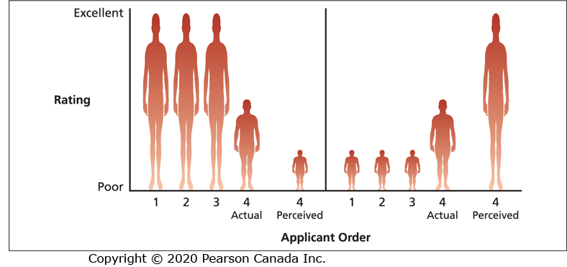
Two Examples of Contrast Effects

Slide 105
Structured Employment Interviews (1 of 3)
Validity improves when the interview is structured.
What is a structured interview?

Slide 106
Structured Employment Interviews (2 of 3)
Interview structure involves four dimensions:
  Evaluation standardization
  Question sophistication
  Question consistency
  Rapport building

Slide 107
Structured Employment Interviews (3 of 3)
Interviews are more likely to be structured when the interviewer has had formal interview training and the focus of the interview is on selection rather than recruitment.

Slide 108
Perceptions and the Performance Appraisal
Once a person is hired, further perceptual tasks confront organization members.
An index of a person’s job performance is required for decisions regarding pay raises, promotions, transfers, and training needs.
Employees with late start times receive lower job performance ratings from their supervisors due to a negative stereotype in which employees with late start times are perceived as less conscientious – this is known as a morning bias.

Slide 109
Objective and Subjective Measures
It is possible to find objective measures of performance for some jobs.
However, as we move up the organizational hierarchy, it becomes more difficult to find objective indicators of performance.
Organizations often rely on subjective measures of employees’ performance provided by managers.

Slide 110
Subjective Measures of Performance
Managers are confronted by a number of perceptual roadblocks.
Managers might not be in a position to observe many instances of effective and ineffective performance.
As a result, the target is frequently ambiguous.
Employees often alter their behaviour so that they look good when their manager is around.

Slide 111
Perceptual Biases in Subjective Performance Appraisals
A subjective performance appraisal is susceptible to some of the perceptual biases discussed earlier:
  Primacy
  Recency
  Stereotypes
A number of other perceptual tendencies occur in performance evaluations that are known as rater errors.

Slide 112
Rater Errors (1 of 2)
Rater errors in performance evaluation include the following:
  Leniency
  Harshness
  Central tendency
  Halo effect
  Similar-to-me effect

Slide 113
Leniency
The tendency to perceive the job performance of ratees as especially good.
Lenient raters tend to give “good” ratings.

Slide 114
Harshness
The tendency to perceive the job performance of ratees as especially ineffective.
Harsh raters tend to give “bad” ratings.

Slide 115
Central Tendency
The tendency to assign most ratees to middle-range job performance categories.
The extremes of the rating categories are not used.

Slide 116
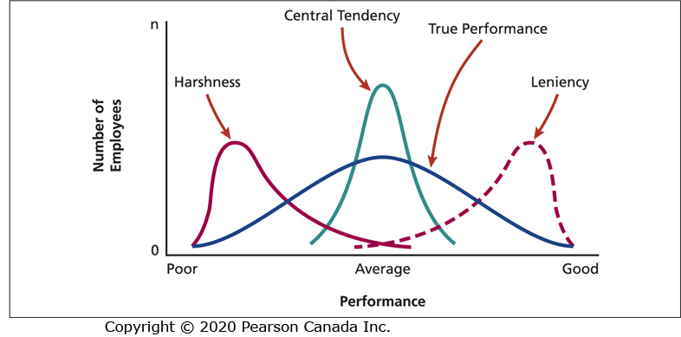
Leniency, Harshness, and Central Tendency Rater Errors

Slide 117
Rater Errors (2 of 2)
These rating tendencies are partially a function of the rater’s personal experiences.
However, not all instances of leniency, harshness, and central tendency necessarily represent perceptual errors.
In some cases, raters intentionally commit these errors.

Slide 118
Halo Effect
The rating of an individual on one trait or characteristic tends to colour ratings on other traits or characteristics.
The rater fails to perceive differences within ratees.
The halo effect tends to be organized around central traits that the rater considers important.

Slide 119
Similar-to-Me Effect
The rater gives more favourable evaluations to people who are similar to the rater in terms of background or attitudes.
Stems from a tendency to view our own performance, attitudes, and background as “good.”
Managers with diverse employees should be especially concerned about this error.

Slide 120
Techniques for Reducing Perceptual Errors and Biases
It is difficult to obtain good subjective evaluations of employee performance.
Human resources specialists have developed techniques for reducing perceptual errors and biases. Two examples of this are:
  Behaviourally anchored rating scale (BARS)
  Frame-of-reference (FOR) training

Slide 121
Behaviourally Anchored Rating Scale (BARS)
Rating scales that give very specific behavioural examples of good, average, and poor performance.
With such an aid, the rater may be less susceptible to perceptual errors.

Slide 122
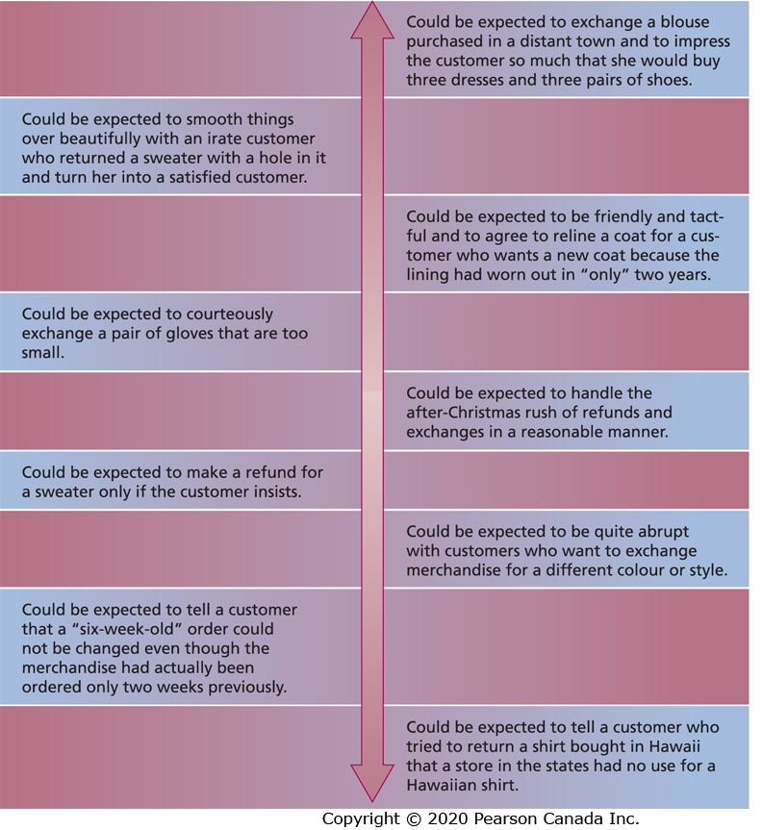
BARS for Rating Customer Service

Slide 123
Frame-of-Reference (FOR) Training
A training method to improve rating accuracy that involves providing raters with a common frame-of-reference to use when rating individuals.
Raters learn what behaviours reflect different levels of performance on each performance dimension and to use the same frame-of-reference when rating all individuals.
Research on FOR training has shown that it is an effective method for improving rating accuracy.

